Slide 1

DriverPass System Analysis
Ray Sauter
Notes:
[No speaker notes required for this slide.]

Slide 2

System Requirements
Functional requirements:
The system shall validate user credentials
when logging in.
The system shall provide the user with
available appointments for them to
schedule.
Non-functional requirements:
The system needs to be run off the web,
preferably over the cloud.
The owner wants to be able to access
data from any computer or mobile device.
Notes:
[In your speaker notes, include an explanation of the different requirements you determined for DriverPass’s system. What are the functional requirements you selected to describe? What are the nonfunctional requirements you selected to describe? Be sure to explain how these requirements meet DriverPass’s needs.]

Slide 3
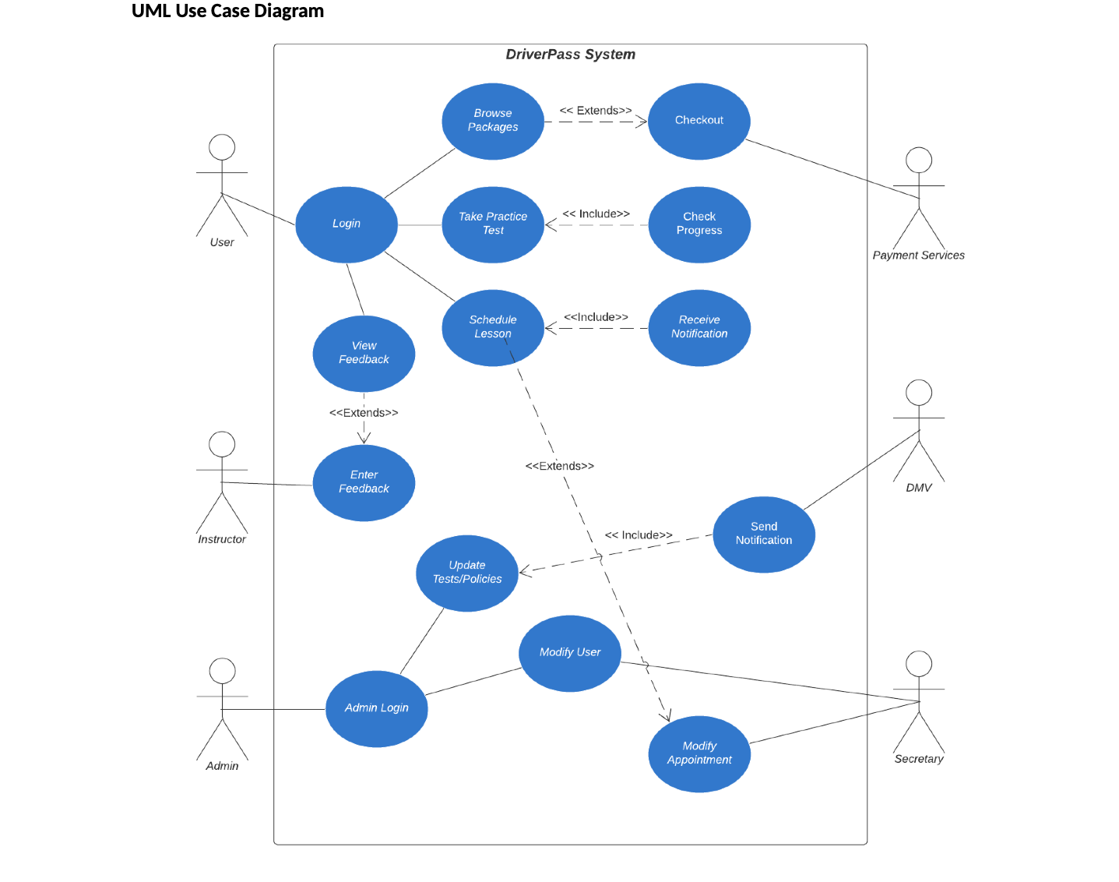
Use Case Diagram
Caption
Notes:
[Explain your diagram. Who are the different actors in the system? What are the different use cases? How did you account for DriverPass’s needs in your design? In your explanation, keep your audience in mind. Avoid the use of terms like “actors” and “use cases” in your explanation.]

Slide 4
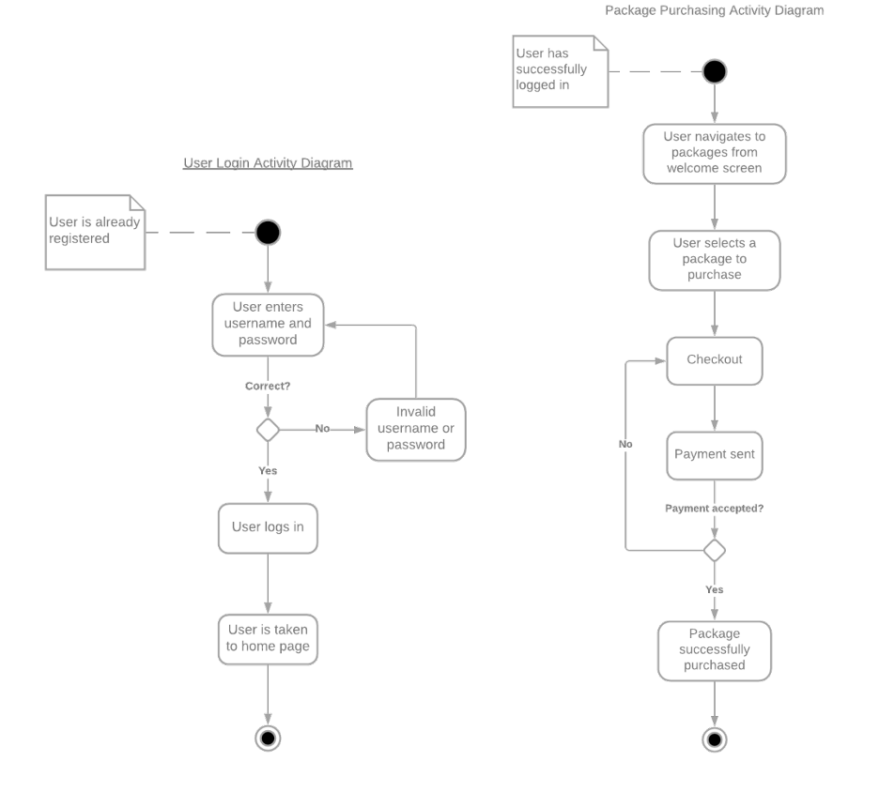
Activity Diagram
Notes:
[Explain your diagram. Which use case are you breaking down? What are the steps for this use case? How did you account for DriverPass’s needs in your design? In your explanation, keep your audience in mind. Avoid the use of technical terms such as “nodes,” “control flows,” and so on.]

Slide 5
Security
The user needs a username and
password to log in to the system.
The connection would be
encrypted to ensure data security.
A user will be locked out of their
account after so many attempts.
If the user forgets their password,
they would be able to reset it
automatically through the system,
or the IT officer would have
Notes:
[How did you consider security in your design? In your explanation, keep your audience in mind by avoiding the use of technical terms.]

Slide 6
System Limitations
The consulting company is small,
resulting in limited resources and
budget
The time frame of the development
period is about three months, with the
collection period taking the first four
months.
As the application is web based, there
will be some limitations in technology.
While mobile was discussed as an
option, specifics on the mobile UI still
need to be made.
Notes:
[What are the limitations of your design? In your explanation, keep your audience in mind by avoiding the use of technical terms.]

